Slide 1
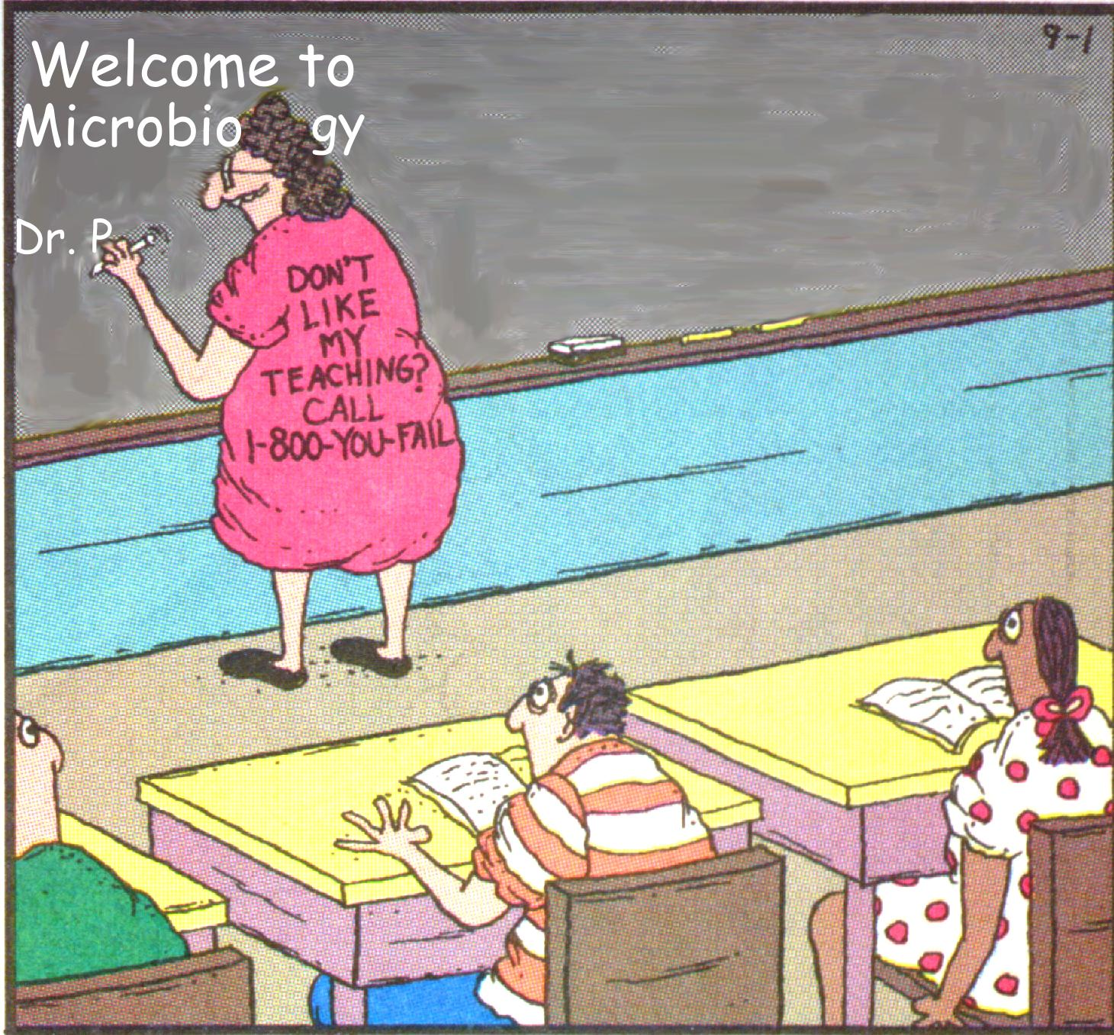

Slide 2
Bacterial control
Ousman Secka
June 2015

Slide 3
Outline
Sterilization (Definition & Methods)
Disinfection (Definition & Methods)
Mechanisms of Antimicrobial Action
Antibacterial Agents

Slide 4
What is Sterilization?
To completely remove all kinds of microbes (bacteria, mycobacteria, viruses, & fungi) by physical or chemical methods.
Effective to kill bacterium spores
3. Sterilant: material or method used to remove or kill all microbes

Slide 5
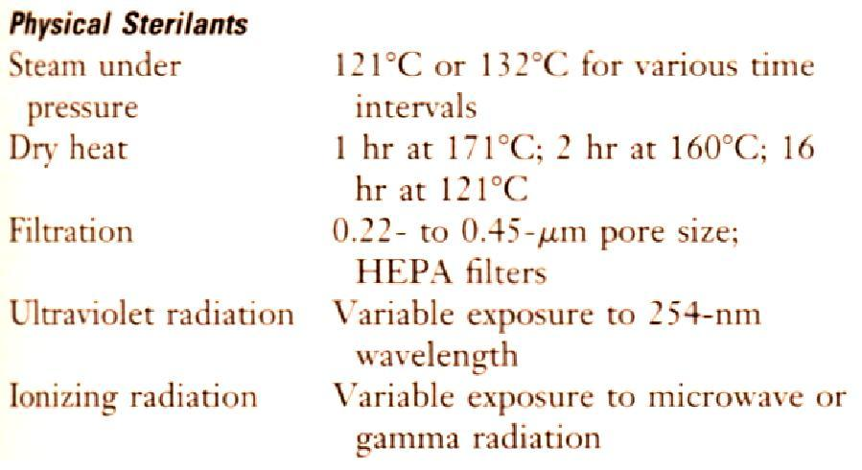
Methods of sterilization (I)

Slide 6
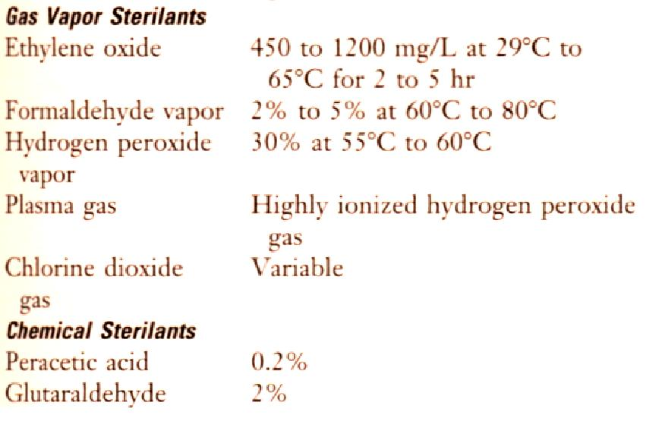
Methods of sterilization (II)

Slide 7
Methods of Sterilization
(Moist heat)
autoclaving
  121ºC (heat/pressure)
Heat resistant materials Autoclave: 121-132ºC for 15 min or longer => Kill both the vegetative and spore forms of the bacteria.
Use Bacillius stearothermophilus spores to monitor the effectiveness of Autoclave

Slide 8
Methods of Sterilization
(Moist heat)
Boiling: boiling for 10 min => Kill most vegetative forms of bacteria
Longer time => Kill spores
Addition of 2% Na₂CO₃ or 0.1% NaOH => enhance destruction of spores and prevent rusting of the metal wares.
Low temperature disinfection (Pasteurization): 62-65 ºC for 30 min. or 71.5ºC for 15 sec. This is mainly used for disinfection of milk.

Slide 9
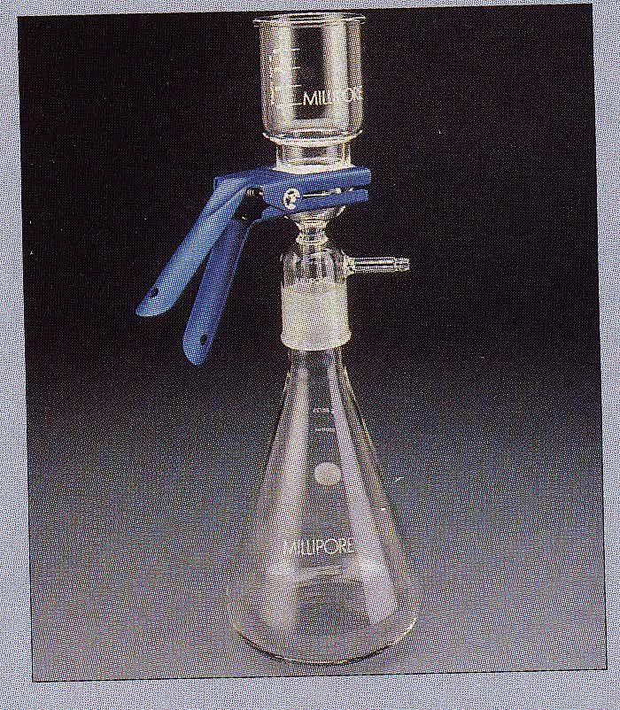
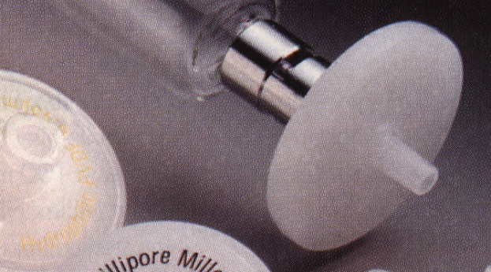
Dry heat
Dry oven: 160ºC for 2 hrs or 171ºC for 1 hr
Flaming; incineration
Radiation
UV-light: UV-radiation causes damage to DNA.
Filtration
The pore size for filtering bacteria, yeasts, and fungi is in the range of 0.22-0.45 mm (filtration membranes are most popular for this purpose).
HEPA filters

Slide 10
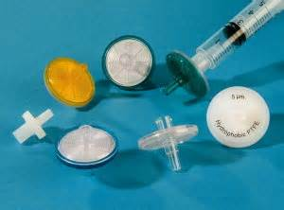
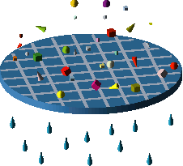
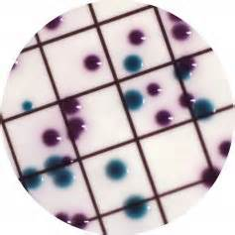
Membrane filters
bacteria
pores
Normally used for heat sensitive constituents e.g. Some sugar solution for biochemical tests.

Slide 11
Methods of Sterilization
Ethylene oxide
  non heat resistant
  Usually equipment
  being replaced e.g. H₂O₂/free radicals
Ultra-violet light
  surfaces (e.g. operating rooms)
    not totally effective
Gamma radiation
  mainly food industry

Slide 12
Pros & Cons of Sterilants (I)
Steam (Moist) & Dry Heat => the most common methods for most materials.
Cons: NO good for heat-sensitive, toxic or volatile chemicals
Filtration => remove bacteria and fungi from air or solutions
eg: HEPA (High-Efficiency Particular Air) filters
Cons: unable to remove viruses and some small bacteria (microplasma)
Ethylene oxide => the most common gas vapor sterilant
Cons: (1) flammable & explosive (2) potential carcinogenic
4. Formaldehyde gas => carcinogenic

Slide 13
What is Disinfection?
To kill most of microbial forms except some resistant organisms or bacterium spores
Categorizing:
High-level ⬄ sterilization
Intermediate
Low level (Not effective for all bacteria or spore)

Slide 14
High-level disinfectants
Used for items involved in invasive procedures but NOT withstand sterilization, e.g. Endoscopes, Surgical instruments

Slide 15
Intermediate-level disinfectants
Used for cleaning surface or instruments without bacterial spores and highly resilient organism, eg. Laryngoscopes, Anesthesia breathing circuits…etc
Low-level disinfectants
Used to treat noncritical instruments and devices, not penetrating into mucosa surfaces or sterile tissues

Slide 16
Considerations of Disinfection
Effectiveness of disinfectants is influenced by
Nature of the item to be disinfected
Number and resilience of the contaminants
Amount of organic material present
Type and concentration of disinfectant
Duration and temperature of exposure

Slide 17
Antisepsis & Antiseptic agents
Use of chemical agents on skin or living tissues to inhibit or eliminate microbes
2. Antiseptic agents are selected for their safety & efficacy

Slide 18
ANTIBIOTICS

Slide 19
Antibiotic/Antimicrobial
Antibiotic:
Chemical produced by a microorganism that kills or inhibits the growth of another microorganism
Antimicrobial agent:
Chemical that kills or inhibits the growth of microorganisms

Slide 20
WHY IS THIS IMPORTANT?
Antibiotics not magic bullet,
has to work together with the immune system
Antibiotics have drastically reduced the number of deaths due to infection
From 1900 to 1980, mortality from infectious diseases dropped from 797 per 100,000 persons to 36 per 100,000 persons.
They have changed the face of health care.
  25-50 % is fed to livestock to increase the rate of weight gain.

Slide 21
HISTORICAL PERSPECTIVES
The discovery of the first antibiotic was an accident.
  Alexander Fleming accidentally contaminated a plate with a fungus.
  He observed a clearly defined region of no bacterial growth where the fungi had contaminated the plate.
  The area around the fungus was eventually referred to as a zone of inhibition.

Slide 22
Fleming and Penicillin

Slide 23
Antibacterial agents
1. A useful chemotherapeutic agent should have in vivo effectiveness and selective toxicity.
2. A fundamental criterion of antibiotics for medical use is selective toxicity??.
The antibiotic should be destructive to the disease-causing organism but have no effect on the human host.

Slide 24
ANTIBIOTIC TARGETS
Antibiotic targets can be subdivided into five major groups:
  The bacterial cell wall
  The bacterial plasma membrane
  Synthesis of bacterial proteins
  Bacterial nucleic acids
  Bacterial metabolism

Slide 25
Mechanisms of Antimicrobial Action
Bacteria have their own enzymes for
  Cell wall formation
  Protein synthesis
  DNA replication
  RNA synthesis
  Synthesis of essential metabolites

Slide 26
Sites of Action of Antibacterial Chemical Agents
Disruption of cell wall
Sites of antibiotic activity

Slide 28

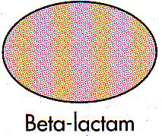
Inhibition of cell wall synthesis
(penicillins, cephalosporins, vancomycin, cycloserine, bacitracin)
b-lactam drugs:
Drugs containing a b-lactam ring, e.g. penicillins and cephalosporins.
Vancomycin: bactericidal for some gram-positive bacteria
PBPs (penicillin-binding proteins): receptors for b-lactam drugs. There are 3-6 PBPs, some of which are transpeptidation enzymes.

Slide 29
Penicillins
Produced by Penicillium chrysogenum
Modifications:
decrease acid lability;
increase absorption;
resistant to penicillinase;
broader spectrum (e.g., ampicillin).
b-lactamase inhibitors: bind b-lactamases irreversibly; combined use with some penicillins to increase effectiveness.
Modifications of cephalosporins were to expand their spectra or increase their stability to b-lactamases.

Slide 30
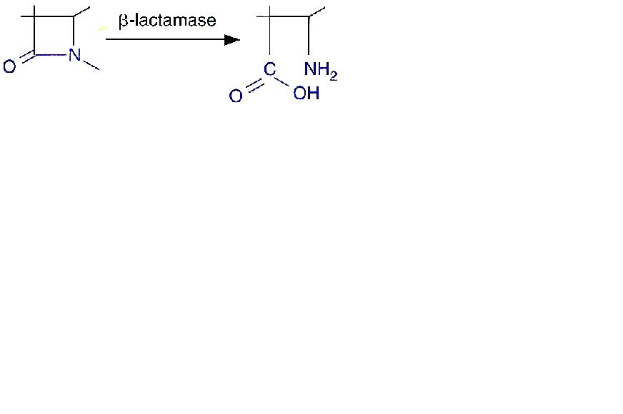
How Bacteria Become Resistant to the b-Lactam Antibiotics?
1. To prevent the interaction between the antibiotic and the target PBP
e.g. Gram-neg (Pseudomonas) => change porins on the pores => exclude antibiotic
2. To modify the binding of the antibiotic to the target PBP
Modified PBP can result from mutation or acquisition of new PBP
3. Hydrolysis of the antibiotic by b-lactamases
- They are in the same family of PBPs
- Over 200 different b-lactamases:
some are specific for penicillins
others have a broad range of activity

Slide 31
Vancomycin
A complex glycopeptide produced by Streptomyces orientalis
Inactive for gram-negative bacteria
Some enterococci have acquired resistance to vancomycin
The resistance genes are carried on plasmids

Slide 32
Polymyxins
1. Cyclic polypeptides (from Bacillus polymyxa)
2. Insert into bacteria outer membrane by interacting with LPS and phospholipids → increase cell permeability → bacterial cell death
3. Most Active for gram-negative bacteria, because Gram-pos bacteria have no outer member
4. External treatment of localized infection and oral administration to sterilize the gut
5. Nephrotoxic

Slide 33
Inhibition of protein synthesis
Aminoglycosides (streptomycin, kanamycin, neomycin, gentamicin, tobramycin, amikacin, etc.): bind irreversibly to 30S ribosomal proteins and inhibit peptide formation; bactericidal. Gm and Tm are ototoxic.
Tetracyclines: inhibit attachment of charged tRNA; bacteriostatic.
Chloramphenicol: binds to peptidyl transferase of ribosome; toxic to bone marrow cells (aplastic anemia); bacteriostatic.
Macrolides (erythromycins, clarithromycin, etc.): bind to 23S rRNA and block peptide elongation.
Lincomycins (clindamycin): resembles macrolides in mode of action.
Oxazolidinones (linezolid): blocks formation of imitiation complex. Active against staphylococci, streptococci and enterococci. No cross-resistance with the above antibiotics. Reserved for multidrug-resistant enterococci.

Slide 34
Resistance to aminoglycosides:
Mutation to ribosomal binding site;
Decreased uptake of antibiotic;
Enzymatic modification of the antibiotic.

Slide 35
Other Inhibitors of Cell Wall Synthesis
Antibiotics effective against Mycobacteria: interfere with mycolic acid synthesis or incorporation
  Isoniazid (INH)
  Ethambutol
Mycolic acids are long fatty acids found in the cell walls of MTB
Mycolic acids gives M. Tuberculosis characteristics that defy medical treatment.
increased resistance to chemical damage and dehydration, and prevent the effective activity of abx.
the mycolic acids allow the bacterium to grow readily inside macrophages, effectively hiding it from the host's immune system

Slide 36
Inhibition of nucleic acid synthesis
quinolones, rifampin, sulfonamides, trimethoprime
Rifampin: inhibits RNA synthesis.
Quinolones and fluoquinolones: blocking DNA gyrase.
Metronidazol: effective to anaerobic bacterial infections. Reduction of its nitro group by bacterial nitroreductase produces cytotoxic compound that disrupts bacterial DNA.
Antimetabolites
Sulfonamides: analogs of p-aminobenzoic acid (PABA) and inhibit synthesis of folic acid, which is an important precursor to the synthesis of nucleic acids.
Trimethoprim: inhibits dihydrofolic acid reductase in synthesis of purines, methionine and glycine.

Slide 37
Competitive Inhibitors
  Sulfonamides (Sulfa drugs)
    Inhibit folic acid synthesis
    Broad spectrum

Slide 38
Genetic origin of drug resistance
Chromosomal
Extrachromosomal (e.g., R plasmids)
Can be transferred by conjugation, transformation, and transduction.

Slide 39
Antimicrobial activity in vivo
Factors affecting the effectiveness of antibiotics in vivo
Environment
Amount of pathogen
State of bacterial metabolic activity
Distribution of drug
Location of organisms
Interfering substances
Concentration of antibiotic
Absorption
Distribution
Variability of concentration

Slide 40
Drug resistance of the microbes
Mechanisms
1. Producing enzymes that degrade or modify the active drugs;
2. Decreasing drug entry;
3. Increasing drug efflux;
4. Increasing the amount of target enzyme;
5. Decreasing affinity of target for drug;
6. Developing an altered metabolic pathway that bypass the reaction inhibited by the drug.

Slide 41
What Factors Promote Antimicrobial Resistance?
Exposure to sub-optimal levels of antimicrobial
Exposure to microbes carrying resistance genes

Slide 42
Inappropriate Antimicrobial Use
Prescription not taken correctly
Antibiotics for viral infections
Antibiotics sold without medical supervision
Spread of resistant microbes in hospitals due to lack of hygiene

Slide 43
Inappropriate Antimicrobial Use cause?
Lack of quality control in manufacture or outdated antimicrobial
Inadequate surveillance or defective susceptibility assays
Poverty or war
Use of antibiotics in foods –
  Antibiotics are used in animal feeds and sprayed on plants to prevent infection and promote growth

Slide 44
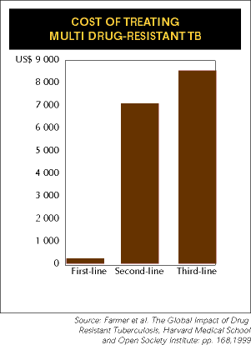
Consequences of Antimicrobial Resistance
Infections resistant to available antibiotics
Increased cost of treatment

Slide 45
Proposals to Combat Antimicrobial Resistance?
Speed development of new antibiotics
Track resistance data nationwide
Restrict antimicrobial use
Direct observed dosing (TB)

Slide 46
ANTIBIOTIC SUSCEPTIBIITY TESTING
© CDC / Gilda L. Jones

Slide 47
TESTING OF ANTIBIOTICS:
Kirby-Bauer Test
An agar plate is covered with known pathogen.
Filter-paper disks impregnated with known concentrations of the compound.
  They are placed on agar.
  Zones of inhibition can be identified.
The method is also used to compare the relative effectiveness of different compounds.
  Large zone of inhibition does not necessarily mean a more powerful compound.
  Zones are evaluated using standardized tables.

Slide 48
Measuring Antimicrobial Sensitivity
E Test
MIC: Minimal inhibitory concentration
MBC concentration

Slide 49
References
Microbiology, A clinical Approach -Danielle Moszyk-Strelkauskas-Garland Science 2010
http://en.wikipedia.org/wiki/Scientific_method
Dr. Alvin Fox, University of South Carolina USA

Slide 50
Lecture
Staphylococci
Dr. Ousman Secka
AIU, 2015

Slide 51
Introduction
Staphyloccocci - derived from Greek “stapyle” (bunch of grapes)
Gram positive cocci arranged in clusters
Include a major human pathogen and skin commensals

Slide 52
Staphylococcus aureus – General features
Facultative anaerobe
Coagulase positive
Gram positive cocci in clusters
Catalase positive
Beta hemolytic colonies on SBA
Produces golden yellow pigment
Highly resistant bacteria
Can grow in the presence of 10 – 15% NaCl

Slide 53
Gram Positive Cocci (GPC)
Staphylococcus (GPCs in clusters)
  Staphylococcus aureus
  S. epidermidis
  S. saprophyticus

Slide 54
Staphylococci v/s Streptococci
In clusters (grapes like) or short chains
Catalase + ve
Facultative anaerobes
Grows on ordinary medium
Major components of normal flora – skin, nose & mucosa
Produces localized infections
Resistant to drying, Penicillin
In chains or in pairs/chains
Catalase -ve
Obligate & facultative anaerobes, grows in 5-10% CO₂
Fastidious – requires enriched medium like BA
Normal flora in throat, colon, female genital tract
Infections tend to spread
Delicate organism, sensitive to penicillin

Slide 55
Clinically Important Species
Many species are medically important
  S. aureus – Coagulase + ve
    Most virulent species
    Most common cause of bacterial infections, food poisoning & toxic shock syndrome
  Coagulase –ve Staphylococci
    S. epidermidis – important cause of prosthetic implant infections
    S. saprophyticus – Urinary Tract Infection in young women

Slide 56
Virulence Factors
Toxins – cytolytic & superantigen exotoxins
Enzymes &
Cell associated polymers and surface proteins

Slide 57
Toxins
Haemolysins - Cytolytic, lyse RBCs of various animal species
Leucocidins - Kills leucocytes
  Enterotoxin A to E - Food poisoning
  heat stable entero toxin acts on gut
  produces severe vomiting following a very short incubation period
  Resolves on its own within about 24 hours
Toxic shock syndrome toxin (TSST/ Enterotoxin F) – Toxic Shock Syndrome: rash, desquamation, multi organ failure
Epidermolytic ( Exfoliative ) toxin A & B – SSSS: Staphylococcal scalded skin syndrome (epidermal splitting & exfoliation)

Slide 58
Extracellular enzymes
Organisms also naturally produce H₂O₂ as a by-product of oxidative metabolism------------oxidative cell damage
Catalase – enhance their survival in phagocytes by inactivating toxic H₂O₂ & free radicals released after the ingestion of staphylococci.
Coagulase - Clots plasma, responsible for ‘tube coagulase test’, confirmatory test for S. aureus
Hyaluronidase - Breaks down hyaluronic acid (connective tissue): initiation & spread of infection
Fibrinolysin (Staphylokinase) - Lyses fibrin clots: spread of infection
Nuclease - hydrolyses DNA
Lipase – Lipolytic: infection of skin & subcutaneous tissue
tissue-degrading enzymes – bacteria spreads

Slide 59
Surface proteins
Protein A - Antiphagocytic
Binds IgG molecules by their Fc region.
In serum, the bacteria will bind IgG molecules in the wrong orientation on their surface
Disrupts opsonization and phagocytosis.
Mutants of S. aureus lacking protein A are more efficiently phagocytosed in vitro, and mutants in infection models have diminished virulence.

Slide 60
Protein A inhibits phagocytosis
PHAGOCYTE
Fc receptor
immunoglobulin
Protein A
BACTERIUM
An Fc receptor (Fragment, crystallizable) region is a protein found on the surface of certain cells of the immune system.
Fc receptors bind to antibodies that are attached to infected cells or invading pathogens. Their activity stimulates phagocytic or cytotoxic cells to destroy microbes, or infected cells.

Slide 61
Pathogenicity
(Staphylococcal diseases)

Slide 62
One of commonest opportunistic
infections _hospital and community:
pneumonia
osteomyelitis
septic arthritis
bacteremia
endocarditis
abscesses/boils
other skin infections

Slide 63
Pathogenicity of S. aureus
Cutaneous infections –
Folliculitis (boils), furuncle, burns and wounds, Boils
Styes
Furuncles (infection of hair follicle)
Carbancles (infection of several hair follicles)
Wound infections (progressive appearance of swelling and pain in a surgical wound after about 2 days from the surgery)
Impetigo (skin lesion with blisters that break and become covered with crusting exudate)

Slide 64
Pathogenicity of S. aureus
Deep infections –
Osteomyelitis, abscesses, pneumonia, endocarditis, septicemia, septic arthritis.
Breast abscess can occur in 1-3% of nursing mothers in puerperiem
Can produce mild to severe disease
Other sites - kidney, brain from septic foci in blood
Predisposing:
Multiple abscesses,septicemia (IV drug users; diabetes)
Staphylococcal pneumonia following viral infections

Slide 65
Pathogenicity of S. aureus
Toxin mediated infections –
  Staphylococcal scalded skin syndrome (SSSS),
Disease of young children
Mediated through minor Staphylococcal infection by ‘epidermolytic toxin’ producing strains
Mild erythema and blistering of skin followed by shedding of sheets of epidermis
Children are otherwise healthy and most eventually recover

Slide 66
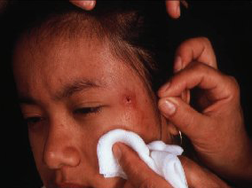
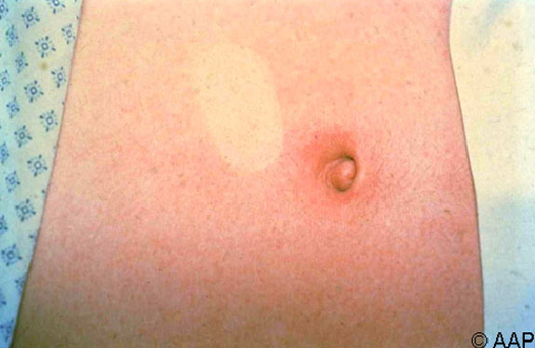
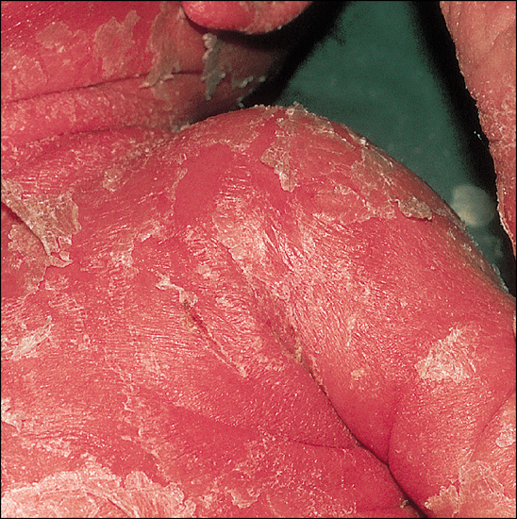
Abscess
Folliculitis
Toxic shock syndrome
SSSS

Slide 67
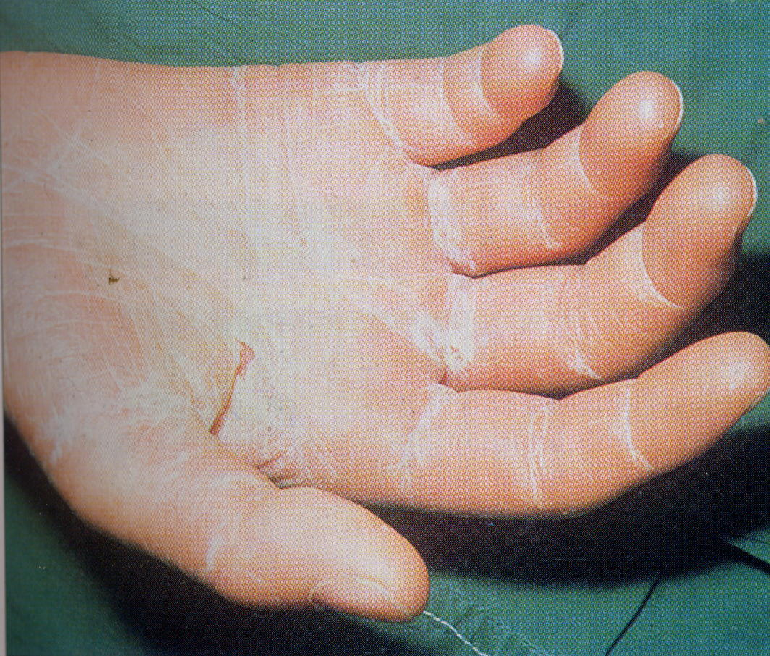

Slide 68
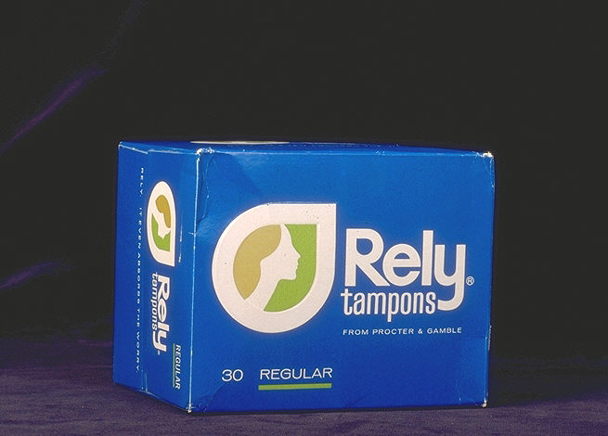
Pathogenicity of S. aureus _Toxic shock syndrome
High fever, diarrhoea, shock and erythematous skin rash which desquamate
Mediated via ‘toxic shock syndrome toxin’
10% mortality rate
Described in two groups of patients
  ass. With young women using tampons during menstruation
  Described in young children and men

Slide 69
Toxic shock syndrome
Fever
Rash
Desquamation
Vomiting
Diarrhea

Slide 70
Food poisoning
  Enterotoxin A to E - Food poisoning
  heat stable entero toxin acts on gut
  produces severe vomiting following a very short incubation period
  Resolves on its own within about 24 hours
Vomiting
Nausea
Diarrhea
Abdominal pain

Slide 71
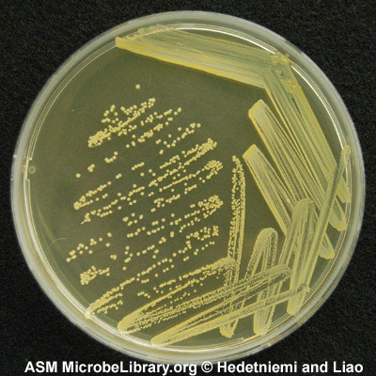
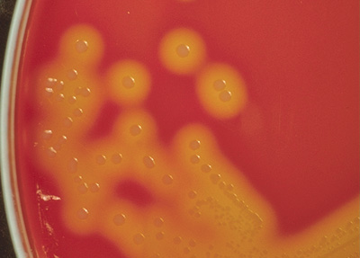

Lab diagnosis – S. aureus
Specimens: wound swab, pus, blood, feces
Microscopy: Gram stain - GPC in clusters
Culture
  BA : beta hemolysis
  NA : golden yellow pigment
Catalase positive
Coagulase positive

Slide 72
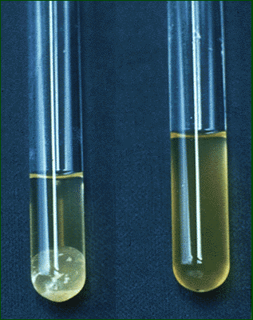
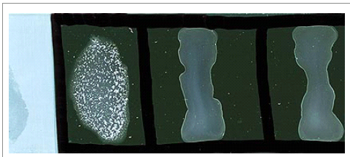
Serological reactions (coagulase test)
One of the most important tests in the classification of staphylococci is their ability to produce coagulase, an enzyme that causes blood clot formation.
Slide agglutination technique
Emulsify a small amount of growth (Staphylococci) from a purity plate in a loopful of sterile normal saline on a clean glass slide
Add a drop of antibody (plasma, stapaurex) and mix
Examine for agglutination
A positive test will show a strong and clear agglutination within 1 minute.
Slide agglutination
Tube agglutination

Slide 73
Catalase test
Catalase is a common enzyme that catalyses the decomposition of hydrogen peroxide to water and oxygen. It is a very important enzyme in protecting the cell from oxidative damage.
Principle
The catalase test is also one of the main tests used to identify species of bacteria.
The presence of catalase enzyme is detected using hydrogen peroxide.
If the bacteria possess catalase, when a small amount of bacterial isolate is added to hydrogen peroxide, bubbles of oxygen are observe

Slide 74
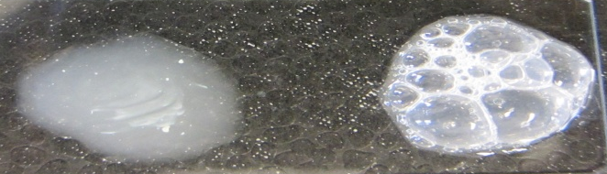
Catalase test……
Procedure
The catalase test is done by placing a drop of hydrogen peroxide on a microscope slide.
Using an applicator stick, a scientist touches the colony, and then smears a sample into the hydrogen peroxide drop.
If the mixture produces bubbles or froth, the organism is said to be 'catalase-positive'
Catalase negative
Catalase positive

Slide 75
Staphylococcus epidermidis
Major member, skin flora
Opportunistic infection
- Less common than S. Aureus
Nosocomial infections
  shunts, catheters
Artificial heart valves/joints

Slide 76
Stapylococcus saprophyticus
S. epidermidis
Coagulase negative staph
Skin commensal/vaginal flora
Imp. Cause of UTI in sexually active young women
Usually sensitive to wide range of antibiotics

Slide 77
Grouping for Clinical Purposes
1. Coagulase positive Staphylococci
  Staphylococcus aureus
2. Coagulase negative Staphylococci
  Staphylococcus epidermidis
  Staphylococcus saprophyticus

Slide 78
Antibiotic therapy
Resistance to penicillin
  penicillinase
β lactam antibiotics (including methicillin for MRSA)
  often ineffective
  modified penicillin binding proteins
Vancomycin
  current drug of choice
  resistance has been observed

Slide 79
Antibiotic sensitivity pattern
Very variable and not predictable
Very imp. In Pt. Management
Mechanisms
  1.B lactamase production - plasmid mediated
    Has made S. aureus resistant to penicillin group of antibiotics - 90% of S. aureus
    B-lactamase stable penicillins (cloxacillin, oxacillin, methicillin) used
  2. Vancomycin is the drug of choice

Slide 80
Methicillin Resistant S. aureus
(MRSA)
Important cause of Nosocomial infections
  post surgical wound infections
  blood stream infections
  ventilator associated pneumonia
Patients with open wounds, invasive devices and weakened immune systems are at greater risk for infection
Person to person spread – mainly from carriers (hospital staff, visitors), 25-30% carry in their nose. By contact with
  colonized or infected patients
  colonized or infected body sites of the personnel themselves,
  devices, items, or environmental surfaces contaminated with body fluids containing MRSA.

Slide 81
Methicillin Resistant S. aureus
(MRSA)
Difficult to treat
Prevention and infection-control strategies
  Screening of staphylococcal carriers among hospital staff
  Treatment of carriers with mupirocin, hexachlorophene
  Proper sanitary procedures – surface sanitation, hand washing (alcohol gels), personal protective measures
  Isolation of patients with open staphylococcal lesions
  * However carrier status prevents complete control
Treatment of MRSA infection - Glycopeptides
  Vancomycin
  teicoplanin

Slide 82
Any Questions?

